Slide 1
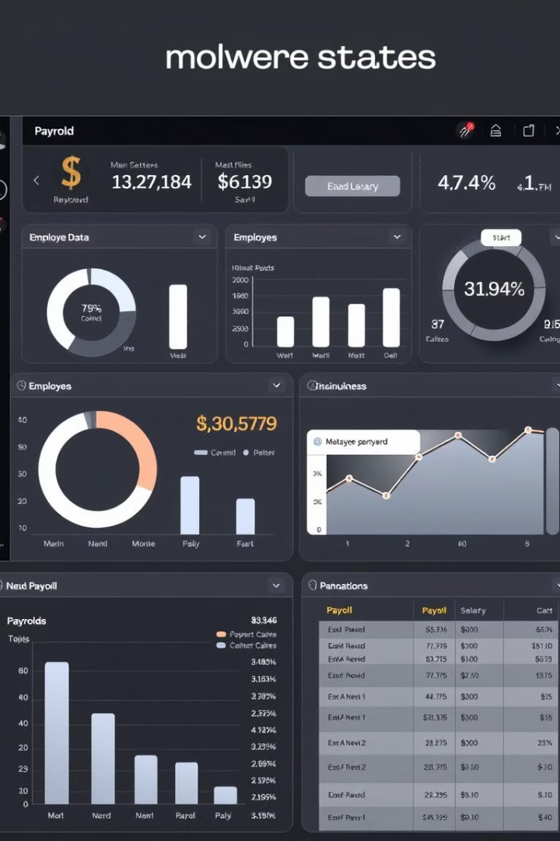
Payroll Management System Banckend
This presentation provides a comprehensive overview of the Payroll Management System's RESTful APIs, covering controllers, data transfer objects (DTOs), and models. It will guide you through the system's functionality and how to interact with its various components.

Slide 2
PayrollManagementApplication
Overview
Annotations
The PayrollManagementApplication class serves as the entry point for the Payroll Management system, a Spring Boot application. It contains the main method, which initializes and runs the application.
@SpringBootApplication: Combines @Configuration, @EnableAutoConfiguration, and @ComponentScan.
@Configuration: Indicates the class can be used by the Spring IoC container as a source of bean definitions.
@EnableAutoConfiguration: Enables Spring Boot's auto-configuration mechanism.
@ComponentScan: Enables component scanning, allowing Spring to discover and register beans.

Slide 3
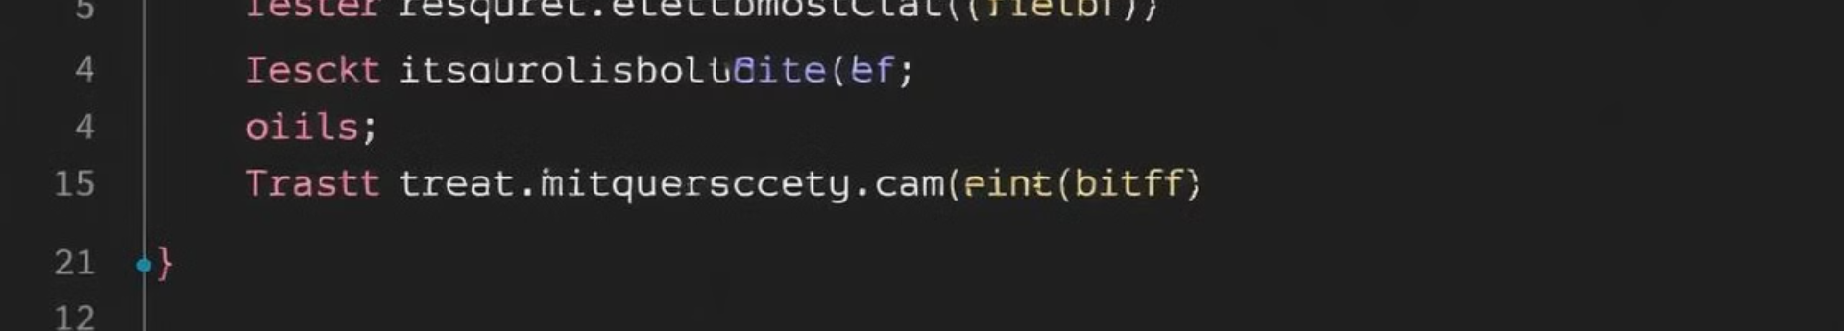
AllowanceController
Overview
Annotations
The AllowanceController is a REST controller responsible for managing allowances. It provides APIs to create, retrieve, update, and delete allowances.
@RestController: Marks the class as a controller where every method returns a domain object instead of a view.
@RequestMapping("/api/allowances"): Defines the base URL for all endpoints in this controller.
@CrossOrigin: Allows cross-origin requests.
@Autowired: Dependency injection is used to inject the AllowanceService instance.

Slide 4
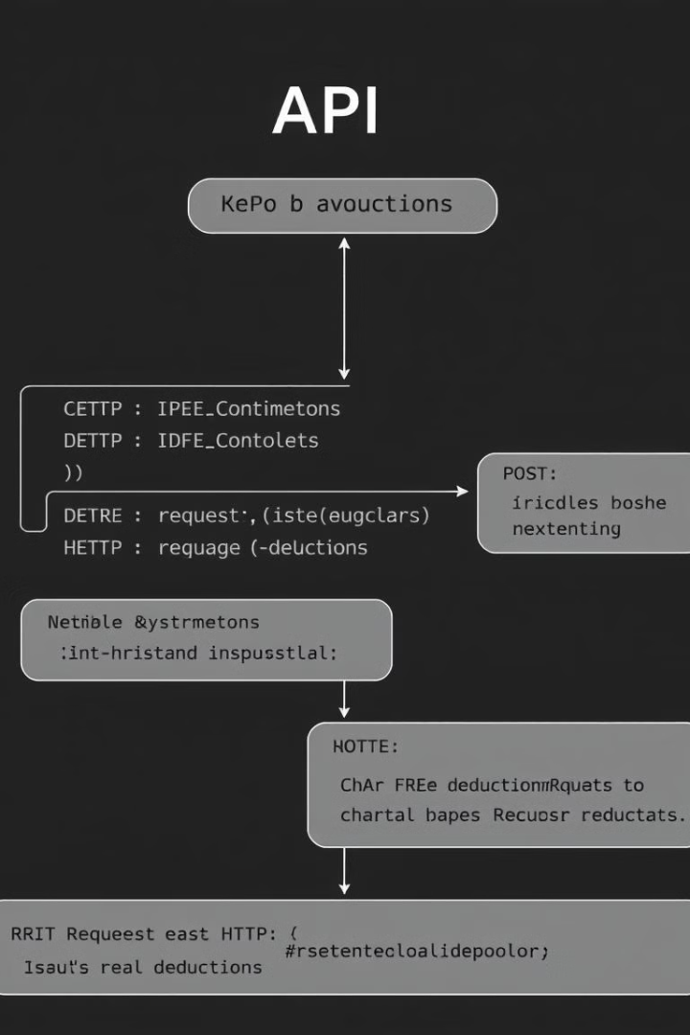
DeductionController
1
Overview
2
Annotations
The DeductionController manages deductions. It provides RESTful APIs for creating, retrieving, updating, and deleting deductions.
@RestController: Marks the class as a REST controller.
@RequestMapping("/api/deductions"): Defines the base URL for the APIs in this controller.
@CrossOrigin: Enables cross-origin requests.
@Autowired: Automatically injects the DeductionService dependency.

Slide 5
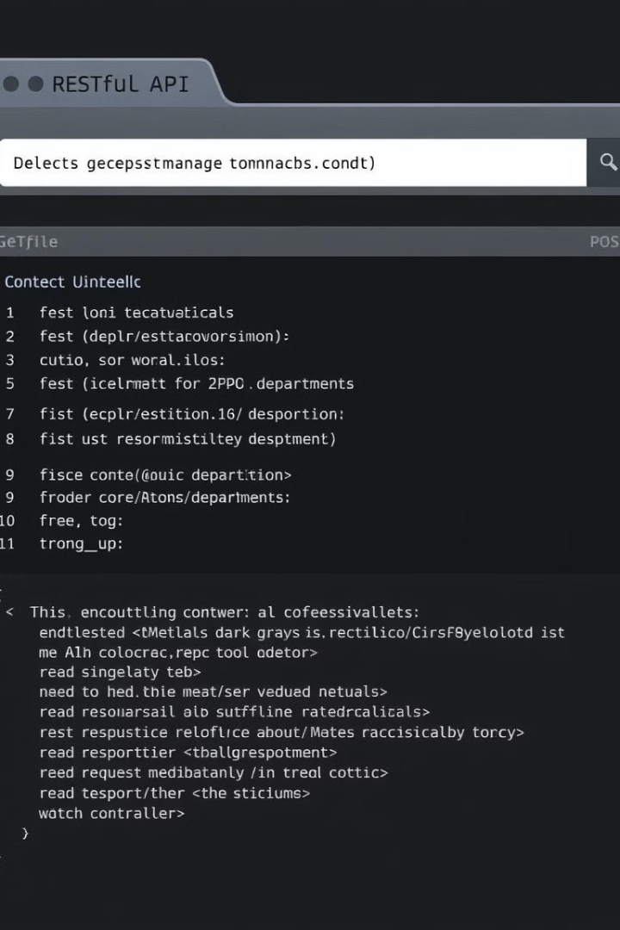


DepartmentController
Overview
Annotations
The DepartmentController is a RESTful controller responsible for managing department-related operations in the Payroll Management system.
@RestController: Indicates that the class is a Spring MVC controller that returns data as JSON or XML instead of views.
@RequestMapping("/api/departments"): Maps HTTP requests to the /api/departments endpoint for all methods in this controller.
@CrossOrigin: Allows Cross-Origin Resource Sharing (CORS) for the controller.

Slide 6
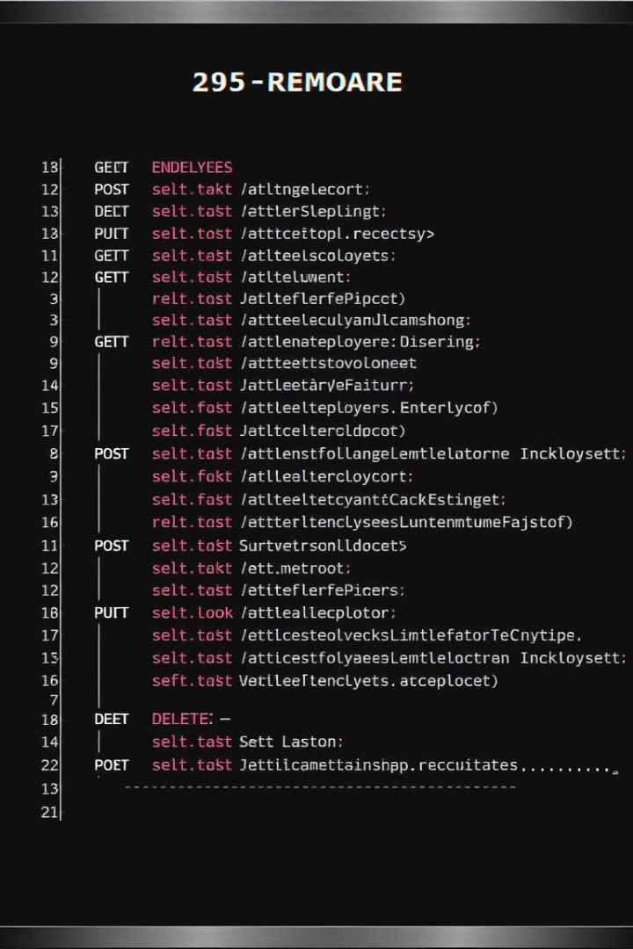
EmployeeController
1
Overview
The EmployeeController is a RESTful controller responsible for managing employee-related operations in the Payroll Management system.
2
Annotations
@RestController: Indicates that the class is a Spring MVC controller that returns data as JSON or XML instead of views.
@RequestMapping("/api/employees"): Maps HTTP requests to the /api/employees endpoint for all methods in this controller.
@CrossOrigin: Allows Cross-Origin Resource Sharing (CORS) for the controller.

Slide 7



HolidayController
Overview
The HolidayController is a RESTful controller responsible for managing holiday-related operations in the Payroll Management system.
Annotations
@RestController: Indicates that the class is a Spring MVC controller that returns data as JSON or XML instead of views.
@RequestMapping("/api/holidays"): Maps HTTP requests to the /api/holidays endpoint for all methods in this controller.
@CrossOrigin: Allows Cross-Origin Resource Sharing (CORS) for the controller.

Slide 8

Key Takeaways
The Payroll Management System provides a comprehensive set of RESTful APIs for managing various aspects of payroll, including allowances, deductions, departments, employees, holidays, jobs, and salaries. The system utilizes Spring Boot and leverages annotations for configuration, auto-configuration, and component scanning. The APIs are designed to be secure, efficient, and easy to integrate with other applications.

